Slide 1

Travel Pack
Prepared for:
Gary Perez
AWS Reinvent Conference
Nov 29th - Dec 4th

Slide 2
Table of Contents
1 | Itinerary
2 | Transit
3 | Entry/Exit Requirements
4 | Hotel
5 | Event Information
 | Confirmed Meetings

Slide 3
Itinerary

Slide 4
Itinerary (Trip Summary)
Date | Time | Event
27 Nov | 23:55 | Depart Nairobi
29 Nov | 09:20 | Arrive Las Vegas
29 Nov | 11:00 | Optional Conference events at The Venetian
29 Nov | 15:00 | Check in MGM Grand
30 Nov | 12:00 | Keynote Address at The Venetian
1 Dec | 14:30 | Meeting with Charlene Xios at The Bellagio
1 Dec | 20:00 | Closing Gala at The Venetian (Black Tie)
2 Dec | 11:00 | Depart Las Vegas
4 Dec | 06:30 | Arrive Nairobi

Slide 5
Transit information

Slide 6
Travel schedule
Carrier | Class | Dep.Date | From | To | Dep | Arr | Arr.Date
Travel to Vegas - 27 hrs 16 mins
Emirates | Business | 27-Nov | Nairobi | Dubai | 23:55 | 5:55 | 28-Nov
Emirates | Business | 28-Nov | Dubai | Los Angeles | 08:30 | 12:45 | 28-Nov
Southwest Airlines | Economy | 29-Nov | San Diego | Las Vegas | 08:00 | 09:20 | 29-Nov
Travel to Nairobi - 32 hrs 20 mins
Alaska Airlines | Business | 2-Dec | Las Vegas | Seattle | 11:00 | 13:51 | 2-Dec
Emirates | Business | 2-Dec | Seattle | Dubai | 16:05 | 18:40 | 3-Dec
Emirates | Business | 4-Dec | Dubai | Nairobi | 02:10 | 06:20 | 4-Dec
Click the links below to open your tickets:
Nairobi to Las Vegas Return Tickets
San Diego - Las Vegas Ticket

Slide 7
Entry/Exit information

Slide 8
Documentation Requirements
ENTRY:
Passport with expiration date more than 6 months from entry date (✔)
US Visa
EXIT:
COVID test from approved facility required no earlier than 1 day prior to departure.

Slide 9
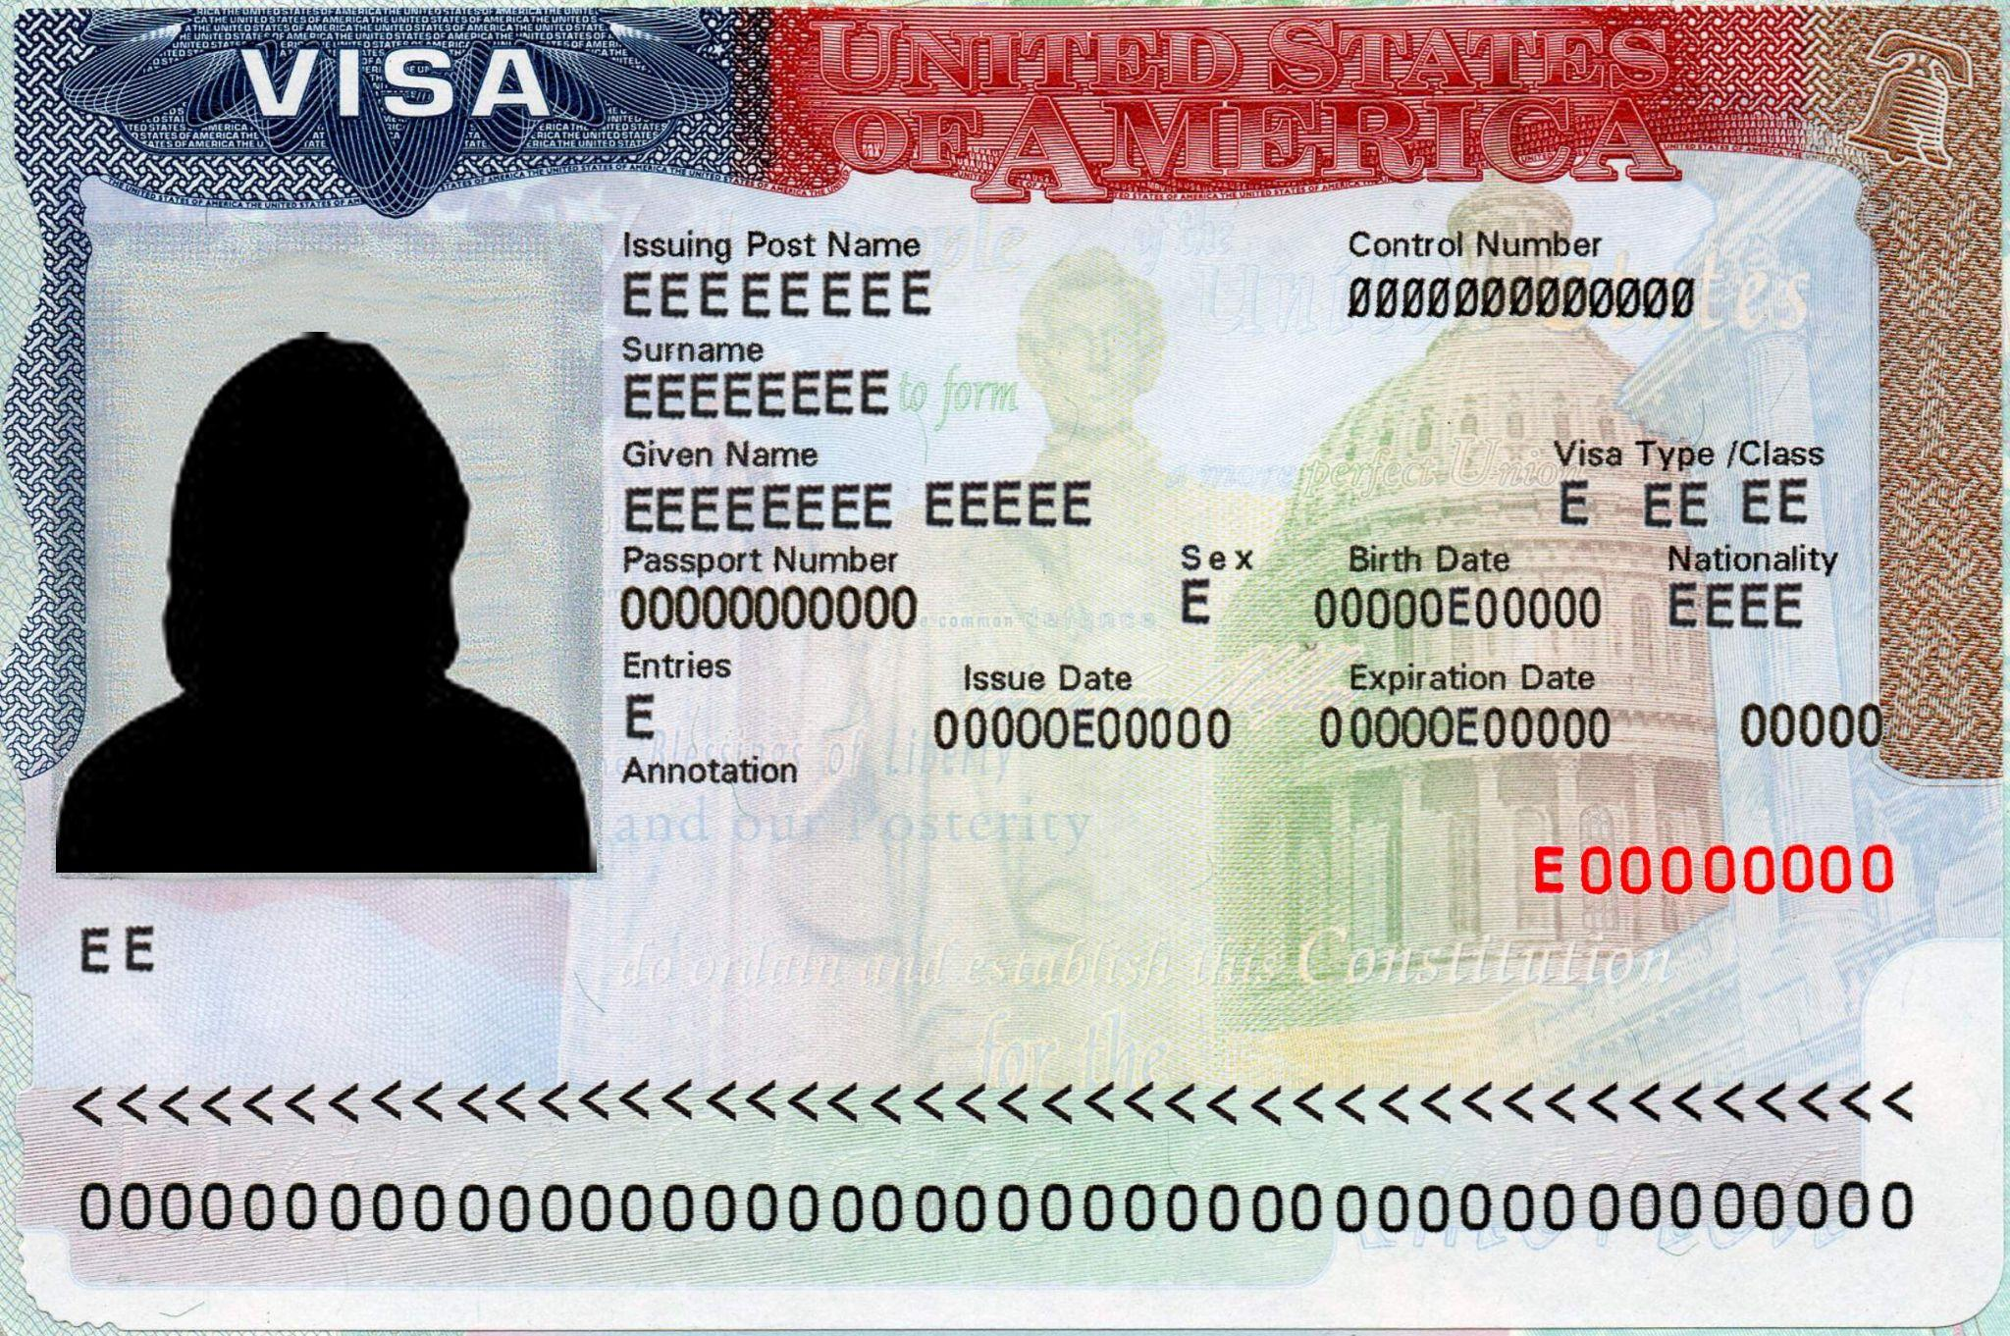
Your US Visa

Slide 10
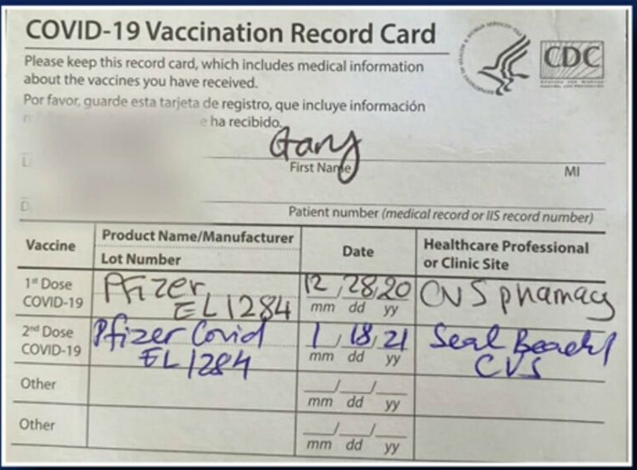
Your COVID Vaccine Card
(May be required to enter some events)

Slide 11
Hotel information

Slide 12
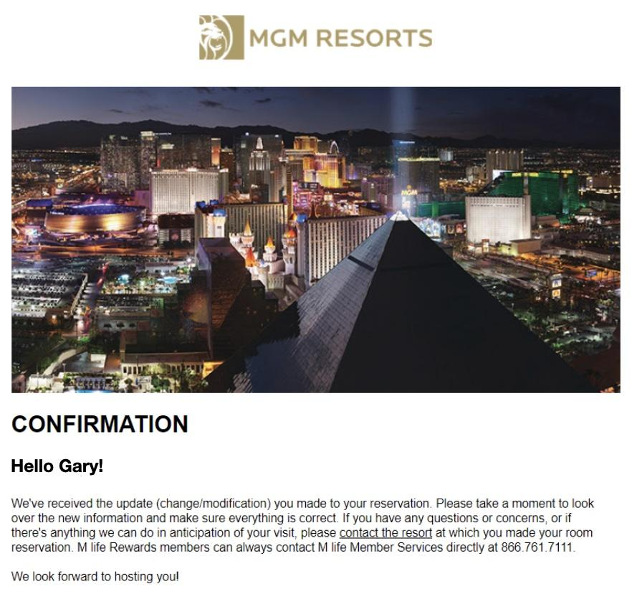
Hotel confirmation

Slide 13
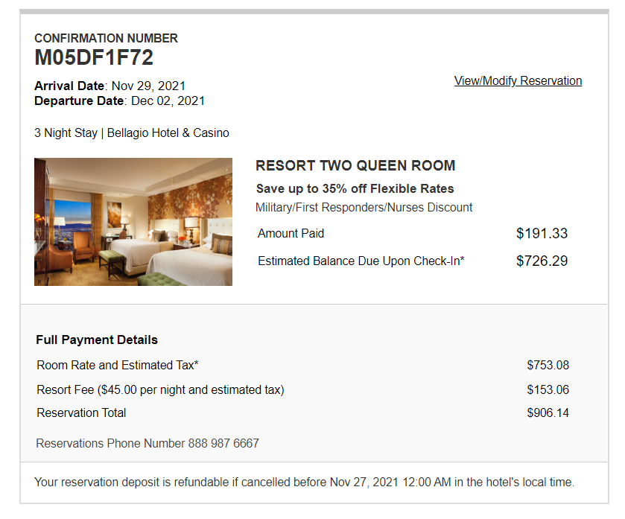
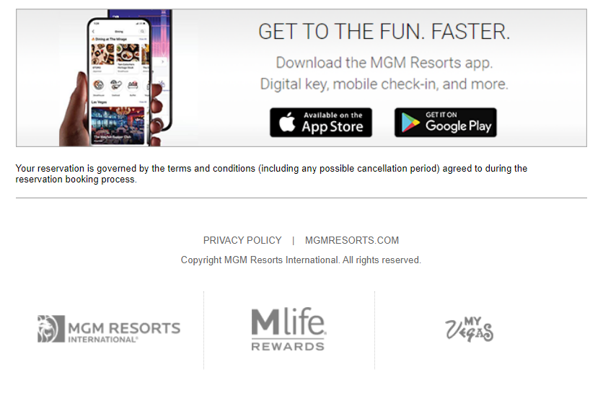
Hotel confirmation

Slide 14
Event information
Invitation letter
Key contacts
Registration confirmation
Conference information
re:Invest campus

Slide 15
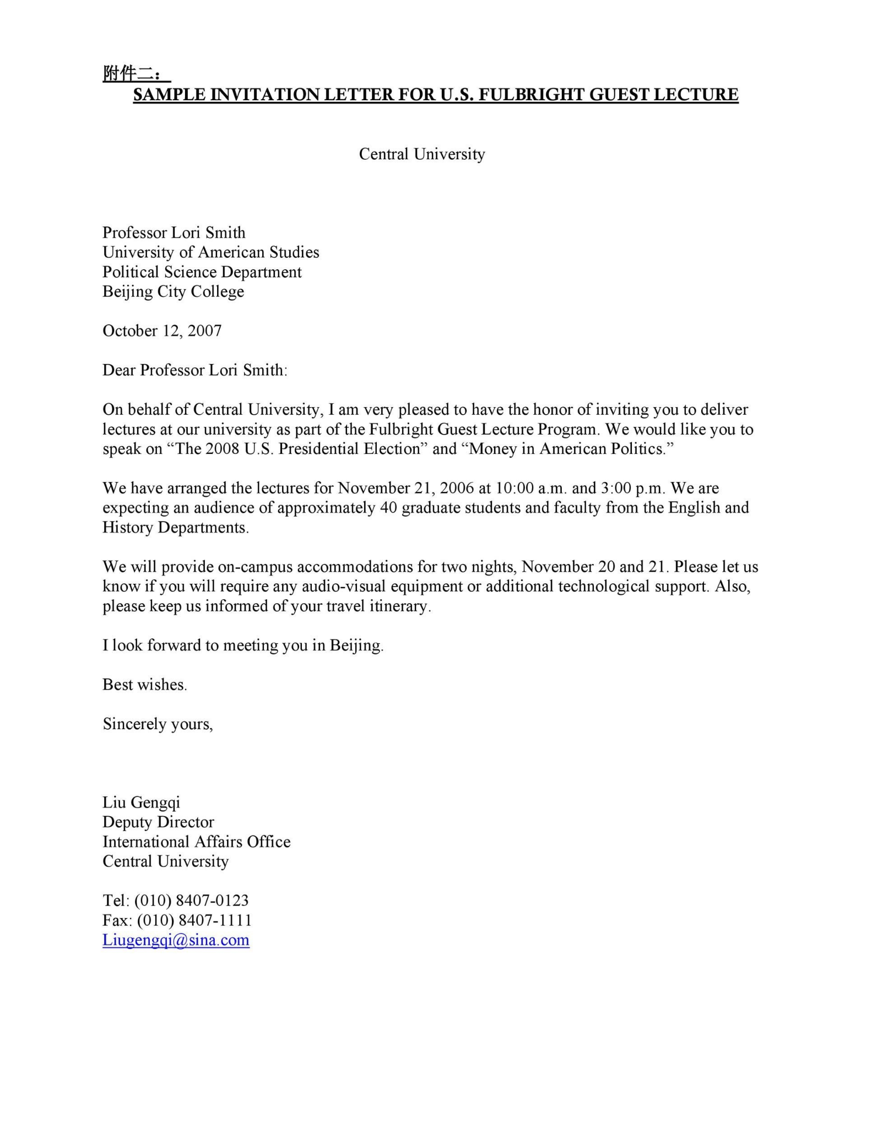
Invitation letter

Slide 16
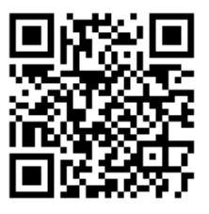
Conference information
COVID Vaccination Verification
All re:Invent badge holders must be fully vaccinated against COVID-19 prior to checking in at the event. Record of COVID-19 vaccination must be provided at onsite check-in to receive your re:Invent badge.
Acceptable records include your physical COVID-19 vaccination/immunization card, a photo of your vaccination/immunization card, or a digital verification from a smartphone application.
Masks
Masks are required for everyone at re:Invent except when eating or drinking. We require attendees to remain stationary while they eat. If attendees are outside a designated meal hall or eating area, they must replace their masks between bites or sips.
Check-in and badge pick-up
Registration opens on Sunday, Nov. 28 at 10:00 AM PT at The Venetian. Please be prepared to present a valid, government-issued photo ID and proof of vaccination to pick up your badge. You'll need your badge to access re:Invent activities and transportation. Use the following QR code to check-in

Slide 17
Conference information
Download the mobile app
The mobile app is your one-stop shop for exploring the event, building and managing your schedule, and learning the latest on transportation.
IOS Link: download here
Getting around
Free campus shuttles for badged attendees run continuously, on direct routes, to and from our campus venues.
Transport options: Discover
Overall Agenda
Browse the high-level agenda for AWS ReInvent 2021 and start planning your week.
Read the agenda: here
You can also access the attendee portal to reserve seats for events you want to attend. Here is your information:
Link: AWS Attendee Portal

Slide 18
AWS re:Invent campus
Welcome to the re:Invent campus in Las Vegas! With four dedicated re:Invent venues, the onsite re:Invent experience offers a unique opportunity to immerse yourself in AWS learning. Key venues include:
Caesars Forum
Events: Breakout content, Content Hub, meals
Encore
Events: Bookable Meeting Space, breakout content
The Venetian | The Palazzo
Events: Breakout content, AWS Certification exams, AWS Certification Lounge, Content Hub, Expo, keynotes, leadership sessions, registration, GameDay, self-paced labs, spotlight labs, SWAG
Wynn
Events: Breakout content, Jams, Content Hub, Bootcamps, meals

Slide 19
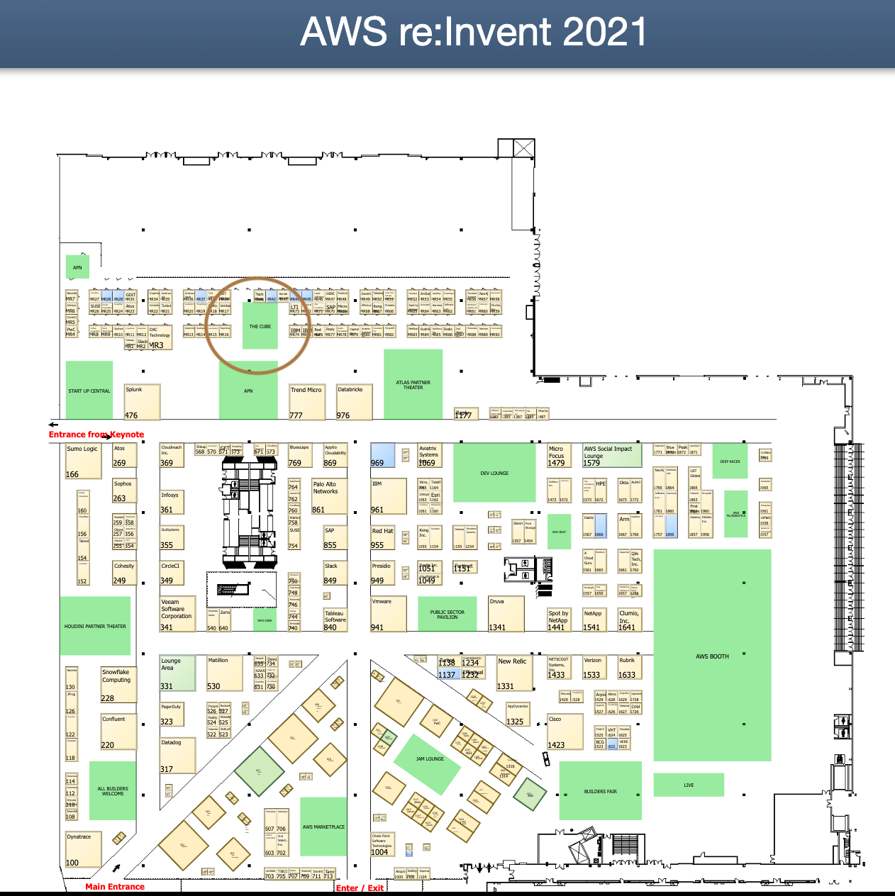
Map

Slide 20
Confirmed meetings

Slide 21
AWS Reinvent Agenda
All events highlighted in yellow are mandatory to attend
Time (PT) | Event | Location
Monday 29th November, 2021
12:00 pm - 12:30 pm | Lunch Meeting Lunch meeting with Sandy Carillo | Encore Hotel Ravel Room
1:45 pm – 2:45 pm | Charting your path to address the AWS skills shortage The race to the cloud is accelerating, and more organizations are looking for support in digital transformation. AWS Partners need the skills to bridge the talent divide to meet customer needs. Discover the key characteristics of a well-skilled AWS Partner, and get an actionable plan from AWS experts on how to create a culture of learning, build in-demand skills, attract and retain new talent, and put your AWS practice on a path to success. | Venetian Level 4, Delfino 4006
3:00 pm – 5:00 pm | Keynote: Global Partner Summit Sandy Carillo, Doug Young, and Chance Orban host the Global Partner Summit keynote, where you’ll learn about cloud-powered innovation and the opportunity it creates for AWS Partners. Learn how AWS Partners use the AWS Cloud to build innovative solutions and services, differentiate their businesses, and enable customers in virtually every industry to transform their businesses. | Venetian Hall A
7:30 pm - 9:30 pm | AWS Public Sector Partner Dinner Hosted by the AWS Public Sector Partner, this dinner is an opportunity to network and connect with AWS partners and team. | Smith & Wollensky Venetian Resort 3377 South Las Vegas Boulevard
Tuesday 30th November, 2021
6:00 am - 6:30 am | Call with Harver Join Peter Mbazi, Rita Hall and the Pacific team to discuss the agreement | Online
8:30 am – 10:30 am | Keynote: Adam Selipsky, AWS CEO | The Venetian Hall A
11:00 am – 12:00 pm | Meeting with Adriana Marjan, CEO of Girls in Robotics | Venetian Brera Restaurant Reservation for 4 under Gary’s name
12:30 pm – 2:00 pm | Women of the C-Suite Lunch Sandy has invited you to join her lunch for Women of the C-Suite focused on the power of storytelling. She has requested that you share a 3-5 minute story that help us share experiences, build understanding, and bring us closer together | The Venetian CUT Steakhouse at the Palazzo
3:30pm – 4:30 pm | Meet with Alejo Mackenzie-Torres and Matt Chomsky, AWS T&C | Wynn Hotel AWS Public Sector Lounge
5:15 pm - 6:15 pm | Re:Invent Leadership Session Rehearsal Rehearsal with Sandy Carillo for the upcoming Leadership Session. Gary only required for second hour. | The Venetian, Level 2 Veronese 2406
6:00 pm – 8:00 pm | AWS Community Happy Hour with Special Guests: AWS Heroes | Venetian Canaletto

Slide 22
Women of the C-Suite Luncheon Agenda
Program
12:30-12:40PM: Arrival/Networking
12:40-12:50PM: Welcome & Main Program (Sandy + Guest Storytellers)
12:50-1:20PM: Facilitated Table Discussions (Table Leaders)
1:20-1:50PM: Table Discussion Sharing (Table Leaders)
1:50-2:00PM: Closing (Sandy)
Notes:
Sandy will introduce you at the beginning of the luncheon. During the Facilitated Table Discussions, you will guide your table’s conversation. Then, during the Table Discussion Sharing, you will be asked for a different volunteer from your table to share the salient points of your discussion with the entire group for 1-2 minutes.
Your Group is: Table 16

Slide 23
Leadership Session Speaker Guide
Onsite Procedures
Venue:
All Leadership Sessions will be presented from the Venetian Theater, located through the Venetian casino, near the Grand Lux Café.
The Exec Speaker Ready Room will be in Venetian, Level 2, Veronese 2406.
A few Exec SRR appointments will take place in Venetian, Level 2, Venetian H. This will be reflected below and in the calendar hold on your calendar if so.
The Green Room and make-up are on the dressing room level of the Venetian Theater.
Access:
You will enter the theater via the elevator on the right of the main entrance doors. We will review this access plan on Sunday, November 28, 2:00p. Due to limited space in the dressing rooms, access is limited to AWS speakers and their EA, customer speaker/s, and business critical session support only.
Customer support teams will not have access to the dressing room level. Customers can attend sessions pending seat availability, but employees are not allowed in sessions.
Your On-Site Schedule
Exec Speaker Ready Room and rehearsal: Tuesday, November 30, 4:15p – 6:15p
Venetian, Level 2, Veronese 2405, 4:15p – 5:15p: Final copyedit of the deck. Track owner/content creator required for this hour. Presenter optional. Venetian, Level 2, Veronese 2406, 5:15p – 6:15p: Rehearsal with Presenter.
Your Leadership Session is Wednesday, December 1, 10:00a – 11:00a
9:00a – 9:30a: Makeup * this is optional, and not required.
Dressing Room 3 will be available for your use from 9:00a – 11:15a. The Stage Manager will look for you in the Dressing Room or the Green Room (where beverages will be available) 15 minutes before the session to bring you up to the stage.

